Slide 1
Assignment No: 03
Submitted By:
Ashfaq Ahmad
Section: B
Reg No: 19pwcse1795
Submitted To:
Ma’am: Madeha Mushtaq
Date: 30-december-22
Department of Computer system Engineering
University of Engineering and technology, Peshawar

Slide 2
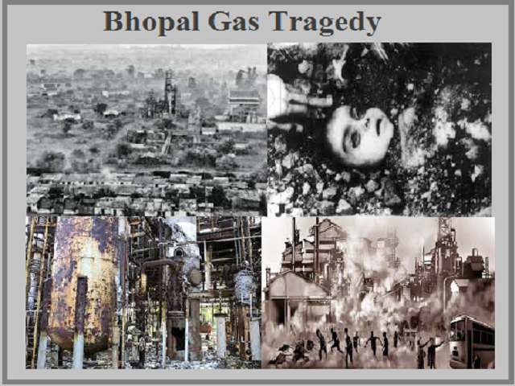
Bhopal Gas Tragedy December 2, 1984

Slide 3
Outlines
Introduction
MIC Manufacturing
First Death
Trade Union
Raj Kaswai
View Of Gas Leakage
Responsibilities And Compensation

Slide 4
Introduction
The Bhopal gas tragedy was a disaster caused by a gas leak at Union carbide India Limited (UCIL) Pesticide plant in Bhopal in 2 December 1984, resulting in thousands of deaths and long-term health problems for many people in the area.
It is considered one of the worst disasters in industrial history and has had a lasting impact on the way industrial safety is regulated worldwide.

Slide 5
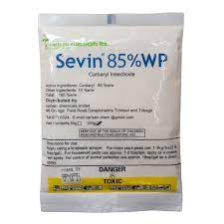
Cont.
Union carbide UC is an American company manufactured a factory in Bhopal in 1969 and named it UCIL.
Union carbide India limited.
Aim is to make special product called sevin.

Slide 6
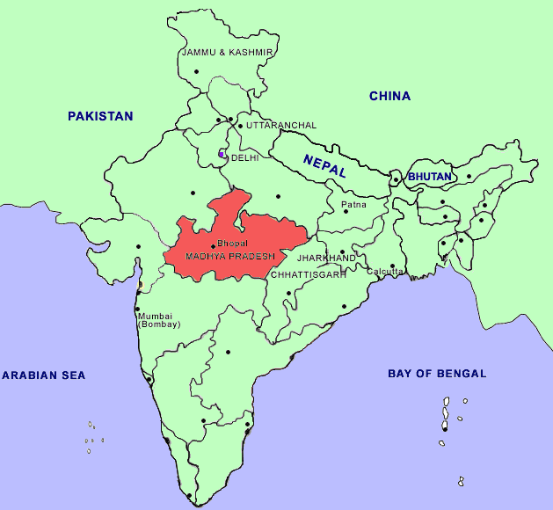

Slide 7
MIC Manufacturing
For manufacturing sevin, special chemical called Methyl Isocyanate was required.
Toxic and dangerous chemical and react highly with water and hydrogen.
India was first importing it.
In 1980, UCIL started money losing.
UCIL started manufacturing of MIC in Bhopal and stored it in three underground tanks.
First Red Flag.

Slide 8
First Death
In 1981 due to leakage of MIC in small amount, one of the worker named Muhammad Ashraf died due to this toxic chemical.
Company didn’t take any action.
He informed his friend Mr. Raj keswai (Indian generalist) about working strategy of company before his death.

Slide 9
Trade Union
In 1982 Trade Union started first protest against this toxic chemical as they know a bit about this toxic chemical.
Printed 6000 posters.
No positive response.

Slide 10
Raj keswai Report
He was an Indian generalist.
Started investigation and accessed the confidential documents.
He wrote a complete report on company about this toxic chemical.
No positive response.

Slide 11
View of Gas leakage
The pips connected to the tanks were cleaned on daily bases.
On 2nd December 1984 9:00 pm, worker was cleaning the pips.
He poured water into pip but from other side it didn’t come out.
Supervisor and worker ignored water.
When worker connected pipes to the tank, water entered into tank and start reaction with MIC which is the most reactive chemical with water.

Slide 12
Cont.
At 11:30 pm the leakage of toxic gas started from the Tank.
they ignored the leakage and went for tea break according to routine till 12:30 pm.
When they came back at 12:30 pm, the leakage of gas was out of control.
Within one hour the toxic gas covered the maximum area of Bhopal which result in thousands of deaths.

Slide 13
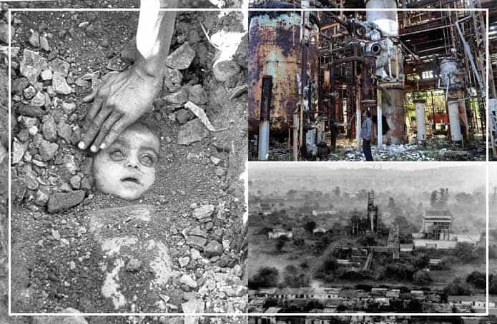
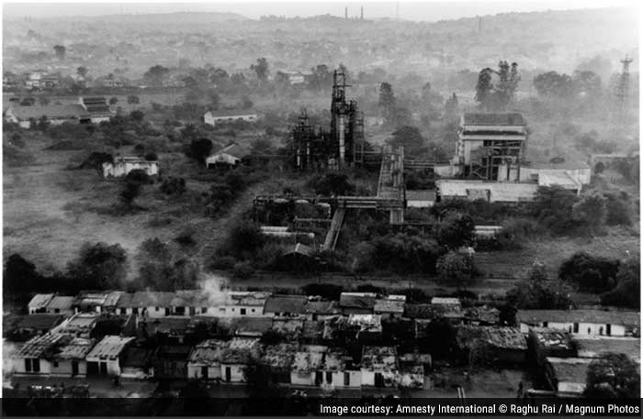

Slide 14
Factors lead to the magnitude of gas leakage
Some safety system had been shut down for five months before disaster to save money.
On disaster night Tanks were filled more than their limit.
The plant did not have adequate safety equipment, such as gas masks and protective clothing.
No effective emergency procedures in place to deal with a gas leak.
Lack of skilled operators - No proper training was given to them.
Maximum population of the Bhopal was settled near UCIL factory.

Slide 15
Responsibility and compensation
GOI was saying it’s a fault of UC that they had not properly trained their workers and also had not provided sufficient safety system.
UC saying it’s a fault of company’s staff they had sabotaged the system by adding water to tank.
In 1989 court case wind up and UC agreed to give $470 million in compensation to GOI.
Bhopal citizens feel that the compensation provided has been inadequate and disaster still continues to be a source of controversy and ongoing legal battle over responsibility and compensation between Bhopal citizens and GOI.

Slide 16
Thank You

